Slide 1
Active Jamming for AF Relay-Based Covert Communications
Refat Khan, Jihwan Moon
Cognitive Communications System Lab
School of Electrical Engineering
Hanbat National University
2024 KIEES Radio Science and Communication Conference
Oct 25, 2024

Slide 2
Introduction
Introduction
Wireless Communication
Securing Wireless Communication
Wireless technology transforms lives, but cyberattacks pose a threat, leading to potential information leaks
To cope with this, cryptography has widely been adopted.
The perspective of physical layer security
Yet, cryptography has limitations: complex key generation and susceptibility to
powerful eavesdroppers, especially challenging for IoT devices.
These downsides have led researchers to examine the possibility of utilizing physical layer security
An approach of secure communications: Covert Communication
Covert communication
Opponents can conduct traffic analysis by collecting metadata during transmission.
Vulnerabilities include capturing source and destination addresses, request-response frequency, etc.
Eve
Alice
Bob

Slide 3
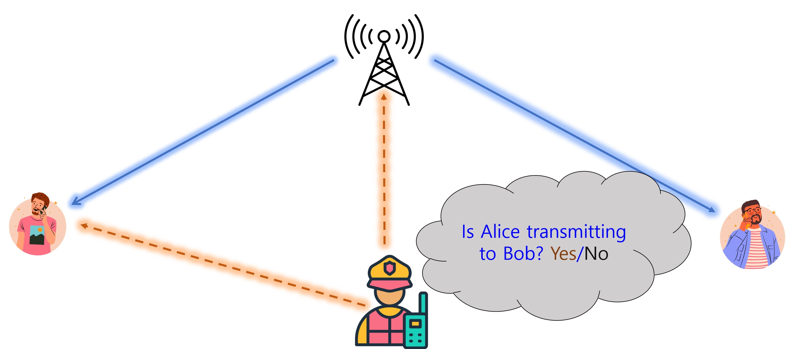
Introduction
Introduction
An approach of secure communications: Covert Communication
Need for Covert Communications
Transmit data in a manner that avoids detection or suspicion.
Combining cryptography and physical layer security can prevent eavesdropping, but covert communications are necessary to counter traffic analysis threats.
Unveiling Covert Communication: AF Relay System
AF Relay :
Simple Implementation, and it does not need to decode or interpret the signal.
It simply scales and forwards the received signal
Stealth Strategy:
Covert message with public message
Using artificial noise
Optimization Goal:
Maximize covert rate, minimize detection
Alice
Carol
Bob
Willie

Slide 4














System Model
System Model Problem Formulation Numerical Result
2.1 Schematic Diagram
Covert message detector
Public message, x_{P}
$$x_{S}$$
$$y_{R}$$
$$y_{D}$$
Source
S
AF Relay
R
Destination
D
Covert message, x_{C}
Artificial
noise, x_{J}
Figure 1. System Model

Slide 5


System Model
System Model Problem Formulation Numerical Result
2.2 Received signals
At the AF relay $R$
$x_{P},x_{C},x_{J}\sim CN\left(0,1\right)$: Public message, covert message and artificial noise, respectively
$P_{S}$: Transmit power at the source
$α_{P},α_{C}∈\left[0,1\right]$: Transmit power allocation for $x_{P}$ and $x_{C}$, respectively, at the source
$α_{J,dB}\sim U\left({\overline{α}}_{J,dB}−ζ_{dB},{\overline{α}}_{J,dB}+ζ_{dB}\right)$: Uniform transmit power allocation in dB for $x_{J}$ at the source
${\overline{α}}_{J,dB}+ζ_{dB}≤0$ dB
$$y_{R}=h_{SR}\sqrt{P_{S}}\left(\sqrt{α_{P}}x_{P}+\sqrt{α_{C}}x_{C}+\sqrt{α_{J}}x_{J}\right)+z_{R}$$
Public message, $x_{P}$
Source
S
AF relay
R

Slide 6

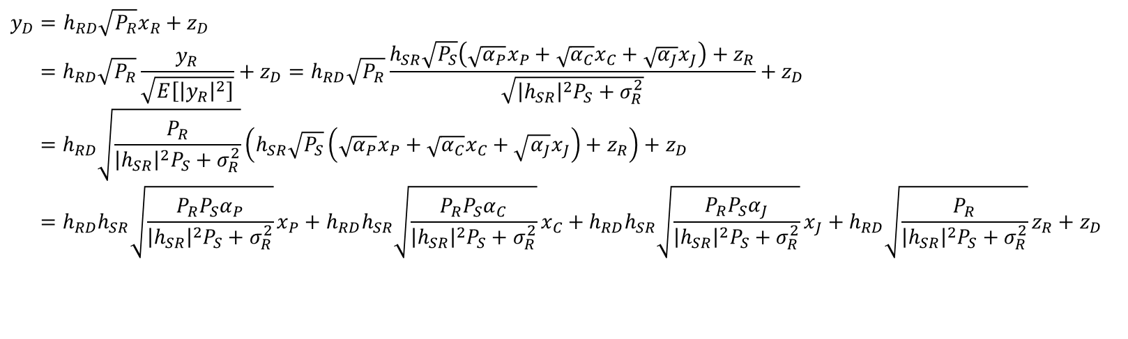
System Model
System Model Problem Formulation Numerical Result
2.2 Received signals
At the destination $D$
$$y_{D}=h_{RD}\sqrt{P_{R}}x_{R}+z_{D} \\ =h_{RD}\sqrt{P_{R}}\frac{y_{R}}{\sqrt{E\left[{\left|y_{R}\right|}^{2}\right]}}+z_{D}=h_{RD}\sqrt{P_{R}}\frac{h_{SR}\sqrt{P_{S}}\left(\sqrt{α_{P}}x_{P}+\sqrt{α_{C}}x_{C}+\sqrt{α_{J}}x_{J}\right)+z_{R}}{\sqrt{{\left|h_{SR}\right|}^{2}P_{S}+σ_{R}^{2}}}+z_{D} \\ =h_{RD}\sqrt{\frac{P_{R}}{{\left|h_{SR}\right|}^{2}P_{S}+σ_{R}^{2}}}\left(h_{SR}\sqrt{P_{S}}\left(\sqrt{α_{P}}x_{P}+\sqrt{α_{C}}x_{C}+\sqrt{α_{J}}x_{J}\right)+z_{R}\right)+z_{D} \\ =h_{RD}h_{SR}\sqrt{\frac{P_{R}P_{S}α_{P}}{{\left|h_{SR}\right|}^{2}P_{S}+σ_{R}^{2}}}x_{P}+h_{RD}h_{SR}\sqrt{\frac{P_{R}P_{S}α_{C}}{{\left|h_{SR}\right|}^{2}P_{S}+σ_{R}^{2}}}x_{C}+h_{RD}h_{SR}\sqrt{\frac{P_{R}P_{S}α_{J}}{{\left|h_{SR}\right|}^{2}P_{S}+σ_{R}^{2}}}x_{J}+h_{RD}\sqrt{\frac{P_{R}}{{\left|h_{SR}\right|}^{2}P_{S}+σ_{R}^{2}}}z_{R}+z_{D}$$
AF relay
R
Destination
D

Slide 7


System Model
System Model Problem Formulation Numerical Result
2.2 Received signals
At the destination $D$
Achievable rate for the public message by treating the covert message as interference
$$r_{P}=\log_{2}\left(1+\frac{{\left|h_{RD}\right|}^{2}{\left|h_{SR}\right|}^{2}\frac{P_{R}P_{S}α_{P}}{{\left|h_{SR}\right|}^{2}P_{S}+σ_{R}^{2}}}{{\left|h_{RD}\right|}^{2}{\left|h_{SR}\right|}^{2}\frac{P_{R}P_{S}α_{C}}{{\left|h_{SR}\right|}^{2}P_{S}+σ_{R}^{2}}+{\left|h_{RD}\right|}^{2}{\left|h_{SR}\right|}^{2}\frac{P_{R}P_{S}α_{J}}{{\left|h_{SR}\right|}^{2}P_{S}+σ_{R}^{2}}+{\left|h_{RD}\right|}^{2}\frac{P_{R}}{{\left|h_{SR}\right|}^{2}P_{S}+σ_{R}^{2}}σ_{R}^{2}+σ_{D}^{2}}\right) \\ =\log_{2}\left(1+\frac{{\left|h_{SR}\right|}^{2}P_{S}α_{P}}{{\left|h_{SR}\right|}^{2}P_{S}α_{C}+{\left|h_{SR}\right|}^{2}P_{S}α_{J}+σ_{R}^{2}+\frac{\left({\left|h_{SR}\right|}^{2}P_{S}+σ_{R}^{2}\right)σ_{D}^{2}}{{\left|h_{RD}\right|}^{2}P_{R}}}\right)$$
$$=\log_{2}\left(1+\frac{γ_{SR}α_{P}}{γ_{SR}α_{C}+γ_{SR}α_{J}+1+\left(γ_{SR}+1\right)γ_{RD}^{−1}}\right) \\ \text{where} γ_{SR}≜\frac{{\left|h_{SR}\right|}^{2}P_{S}}{σ_{R}^{2}}\text{, }\text{and} γ_{RD}≜\frac{{\left|h_{RD}\right|}^{2}P_{R}}{σ_{D}^{2}}$$

Slide 8

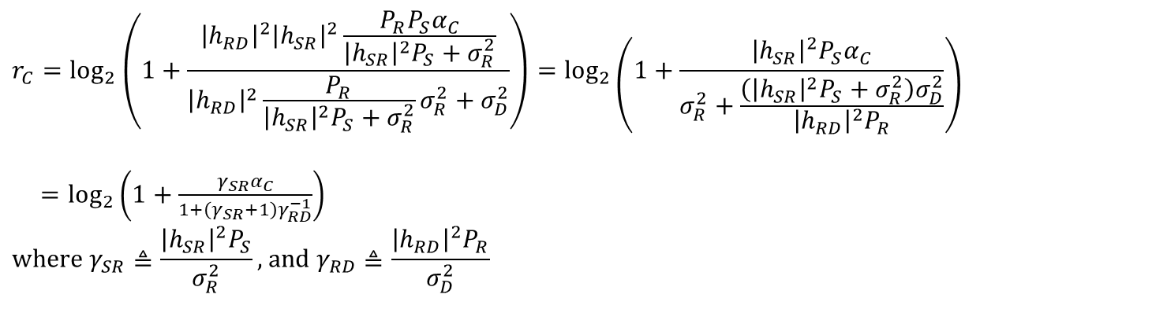
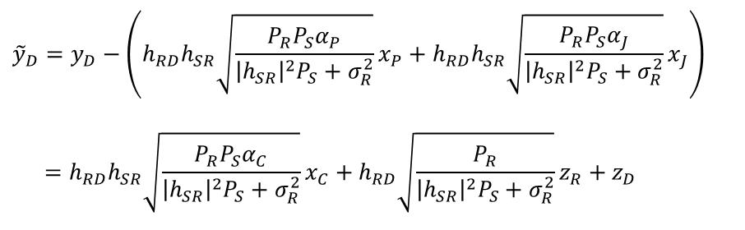
System Model
System Model Problem Formulation Numerical Result
2.2 Received signals
At the destination $D$
Achievable rate for the covert message after canceling the decoded public message and artificial noise by cooperation between $S$ and $D$ to have ${\tilde{y}}_{D}$
$${\tilde{y}}_{D}=y_{D}−\left(h_{RD}h_{SR}\sqrt{\frac{P_{R}P_{S}α_{P}}{{\left|h_{SR}\right|}^{2}P_{S}+σ_{R}^{2}}}x_{P}+h_{RD}h_{SR}\sqrt{\frac{P_{R}P_{S}α_{J}}{{\left|h_{SR}\right|}^{2}P_{S}+σ_{R}^{2}}}x_{J}\right)$$
$$=h_{RD}h_{SR}\sqrt{\frac{P_{R}P_{S}α_{C}}{{\left|h_{SR}\right|}^{2}P_{S}+σ_{R}^{2}}}x_{C}+h_{RD}\sqrt{\frac{P_{R}}{{\left|h_{SR}\right|}^{2}P_{S}+σ_{R}^{2}}}z_{R}+z_{D}$$
Cancellable by cooperation between $S$ and $D$
$$r_{C}=\log_{2}\left(1+\frac{{\left|h_{RD}\right|}^{2}{\left|h_{SR}\right|}^{2}\frac{P_{R}P_{S}α_{C}}{{\left|h_{SR}\right|}^{2}P_{S}+σ_{R}^{2}}}{{\left|h_{RD}\right|}^{2}\frac{P_{R}}{{\left|h_{SR}\right|}^{2}P_{S}+σ_{R}^{2}}σ_{R}^{2}+σ_{D}^{2}}\right)=\log_{2}\left(1+\frac{{\left|h_{SR}\right|}^{2}P_{S}α_{C}}{σ_{R}^{2}+\frac{\left({\left|h_{SR}\right|}^{2}P_{S}+σ_{R}^{2}\right)σ_{D}^{2}}{{\left|h_{RD}\right|}^{2}P_{R}}}\right)$$
$=\log_{2}\left(1+\frac{γ_{SR}α_{C}}{1+\left(γ_{SR}+1\right)γ_{RD}^{−1}}\right)$ $$\text{where} γ_{SR}≜\frac{{\left|h_{SR}\right|}^{2}P_{S}}{σ_{R}^{2}}\text{, }\text{and} γ_{RD}≜\frac{{\left|h_{RD}\right|}^{2}P_{R}}{σ_{D}^{2}}$$

Slide 9

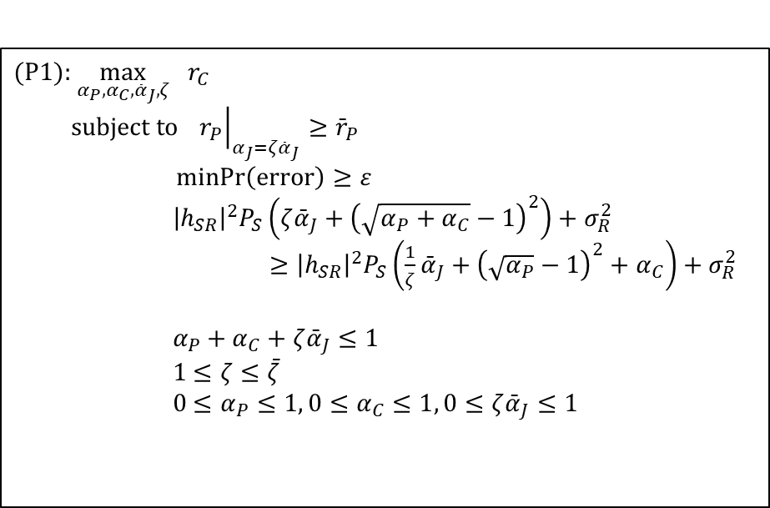
Problem Formulation
System Model Problem Formulation Numerical Result
Covert rate maximization
Objective function
Covert rate
Constraint 1
Minimum public rate threshold ${\overline{r}}_{P}$
The worst-case with $α_{J}←ζ{\overline{α}}_{J}$
Constraint 2
Minimum DEP threshold $ε$
Constraint 3
To avoid zero DEP
Constraint 4
The sum of power proportion
Constraint 5
Maximum artificial noise power bound
Constraint 6
Individual power proportion
$$(\text{P}\text{1})\text{: }\max_{α_{P},α_{C},{\bar{α}}_{J},ζ} r_{C} \\ \text{subject} \text{to} {\left.r_{P}\right|}_{α_{J}=ζ{\bar{α}}_{J}}≥{\bar{r}}_{P} \\ \operatorname{minPr}\left(\text{error}\right)≥ε \\ {\left|h_{SR}\right|}^{2}P_{S}\left(ζ{\bar{α}}_{J}+{\left(\sqrt{α_{P}+α_{C}}−1\right)}^{2}\right)+σ_{R}^{2}$$
$≥{\left|h_{SR}\right|}^{2}P_{S}\left(\frac{1}{ζ}{\bar{α}}_{J}+{\left(\sqrt{α_{P}}−1\right)}^{2}+α_{C}\right)+σ_{R}^{2}$
$$α_{P}+α_{C}+ζ{\bar{α}}_{J}≤1 \\ 1≤ζ≤\bar{ζ} \\ 0≤α_{P}≤1, 0≤α_{C}≤1, 0≤ζ{\bar{α}}_{J}≤1$$

Slide 10
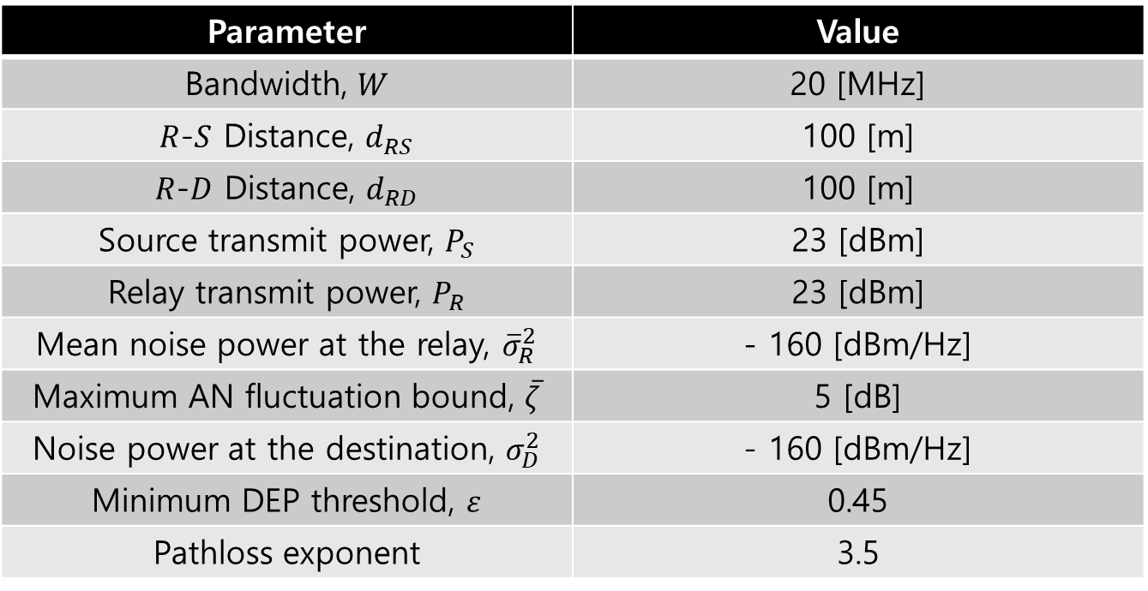
Numerical Result
System Model Problem Formulation Numerical Result
System parameter

Slide 11
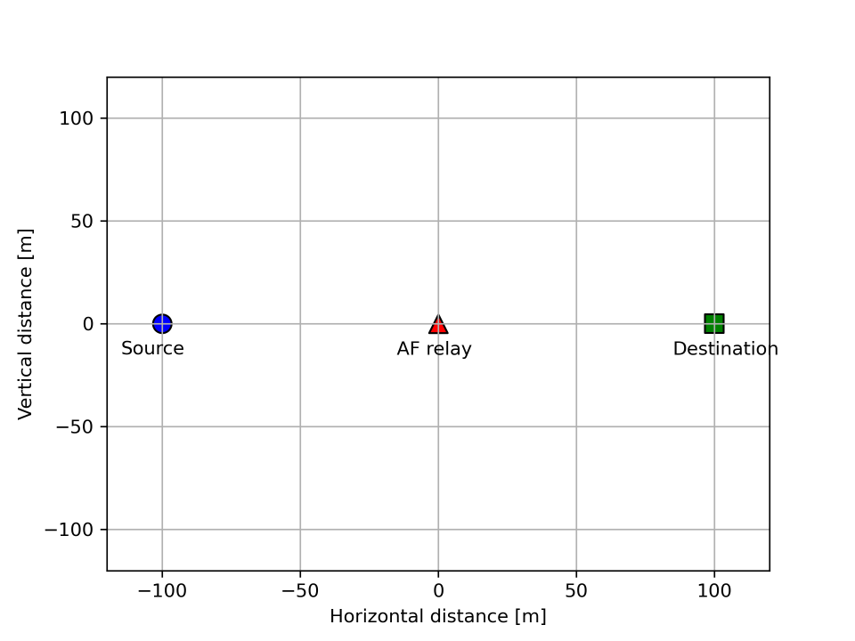
Numerical Result
System Model Problem Formulation Numerical Result
Node Location

Slide 12
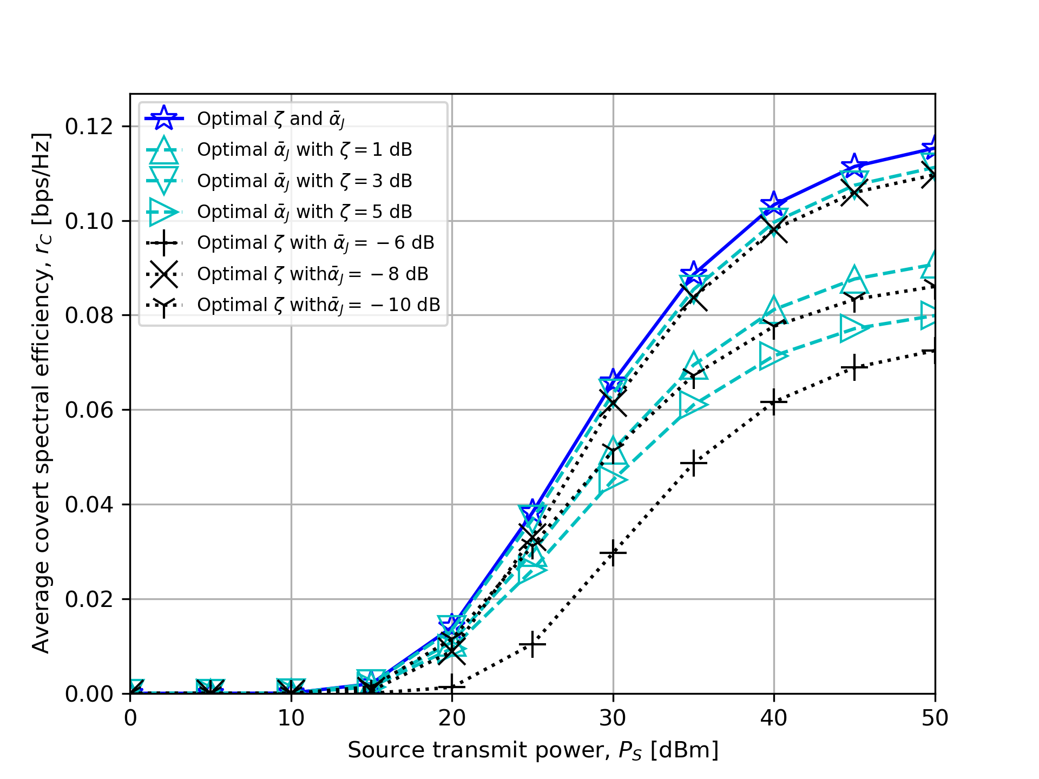
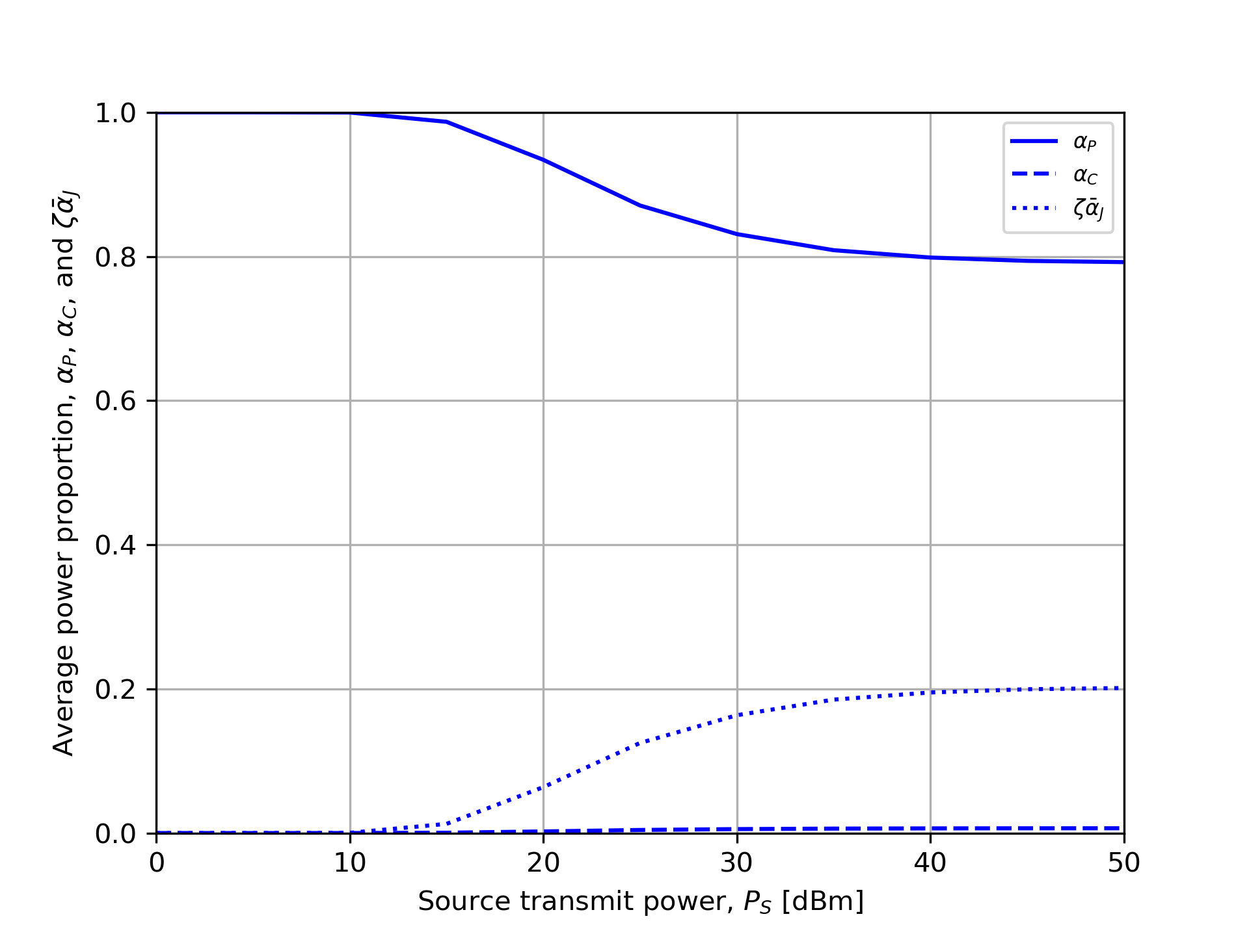
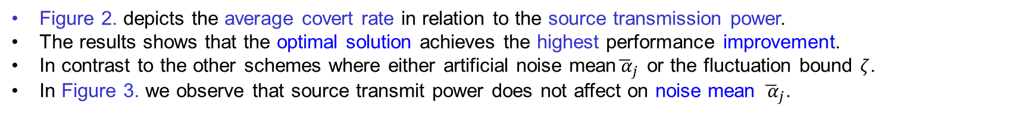

Numerical Result
System Model Problem Formulation Numerical Result
Source transmit power, $P_{S}$
Figure 2. Source transmit power vs average covert rate
Figure 3. Source transmit power vs average power proportion
Figure 2. depicts the average covert rate in relation to the source transmission power.
The results shows that the optimal solution achieves the highest performance improvement.
In contrast to the other schemes where either artificial noise mean${\overline{ α}}_{j}$ or the fluctuation bound $ζ$.
In Figure 3. we observe that source transmit power does not affect on noise mean ${\overline{ α}}_{j}$.

